Slide 1
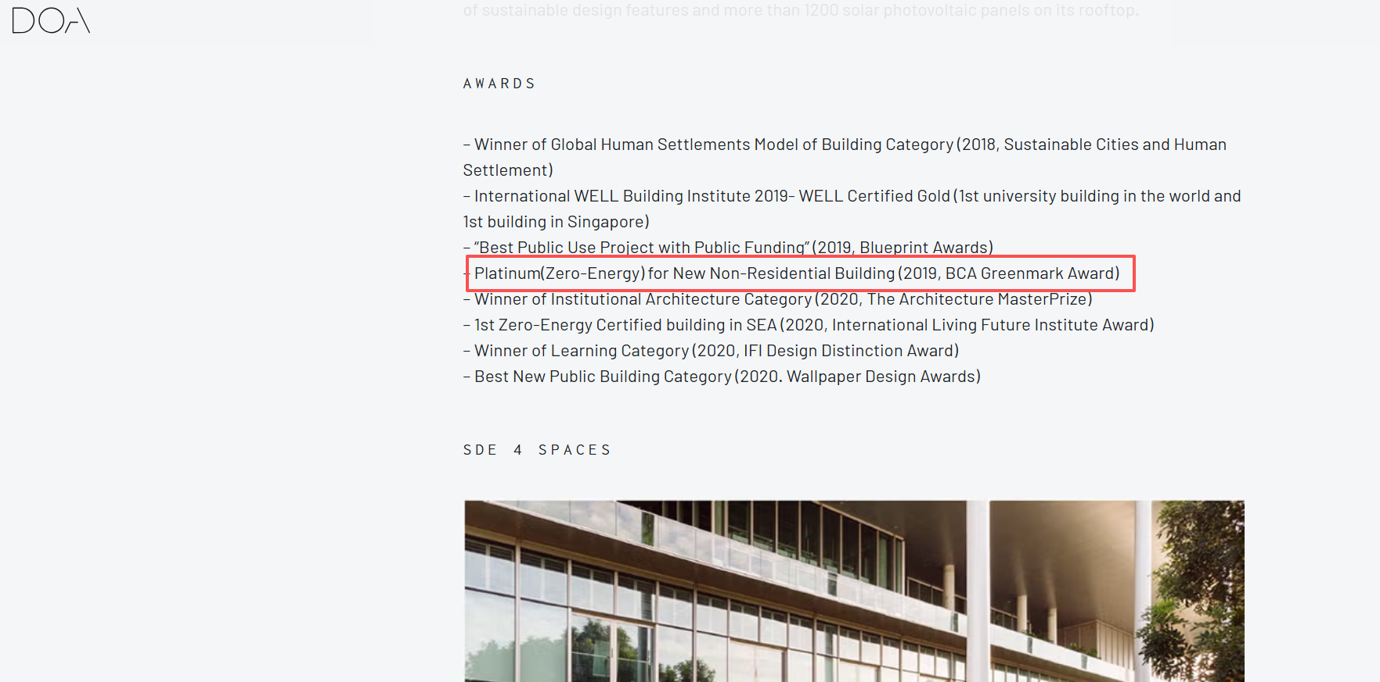
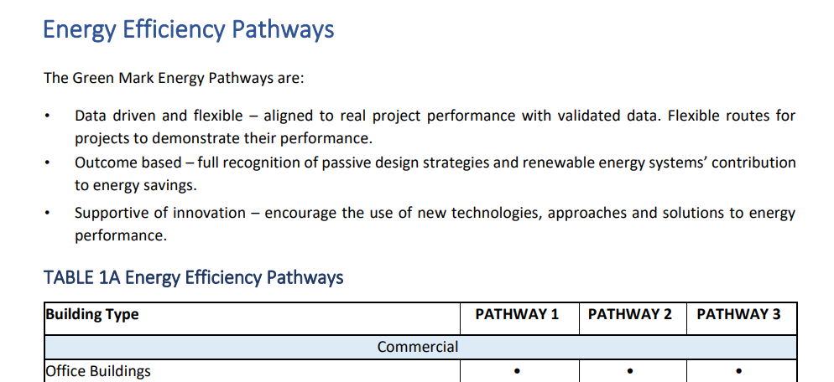
Lighting Energy Standard
https://www1.bca.gov.sg/docs/default-source/docs-corp-buildsg/sustainability/20210909_energy-technical-guide_r1.pdf
https://cde.nus.edu.sg/arch/cdig/cdig-sde-4/
There are 3 pathways in the BCA energy technical guide. We should satisfy all the pathways.
SDE4 is platinum

Slide 2
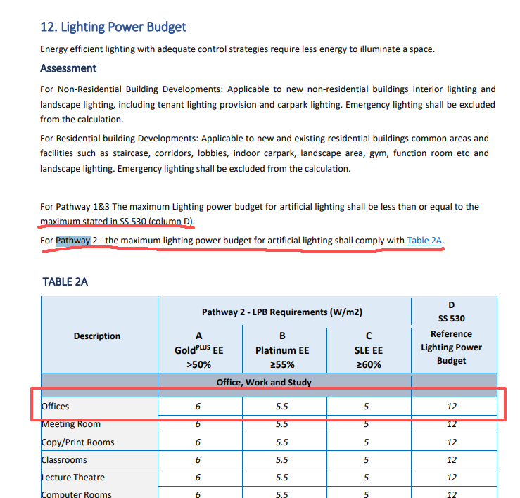
Lighting Energy Standard
SDE4 is Platinum
Offices maximum light power budget should be less than 5.5 W/m2
https://www1.bca.gov.sg/docs/default-source/docs-corp-buildsg/sustainability/20210909_energy-technical-guide_r1.pdf

Slide 3
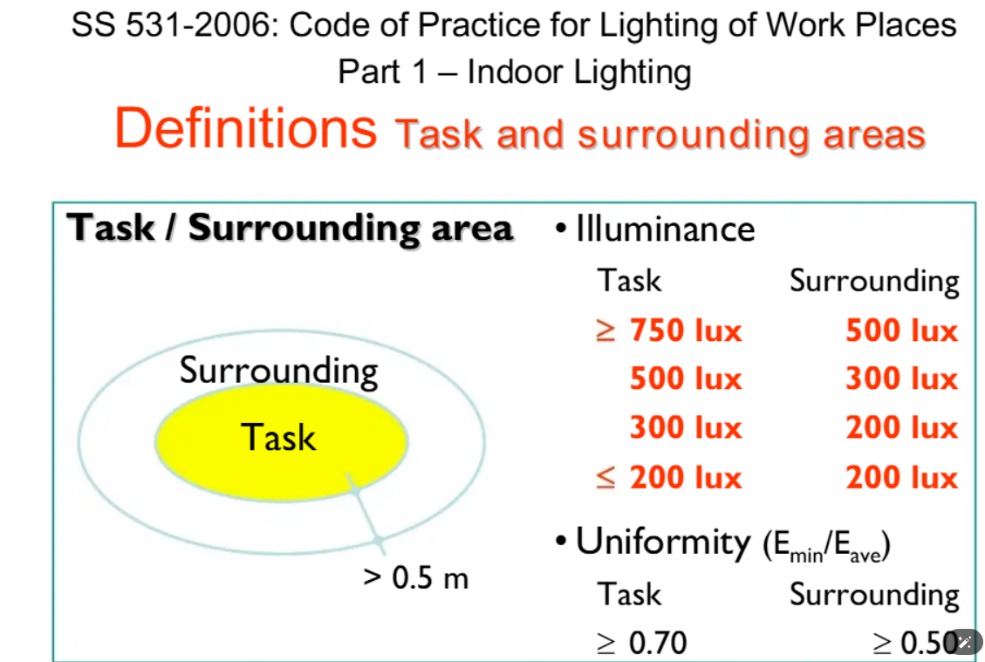
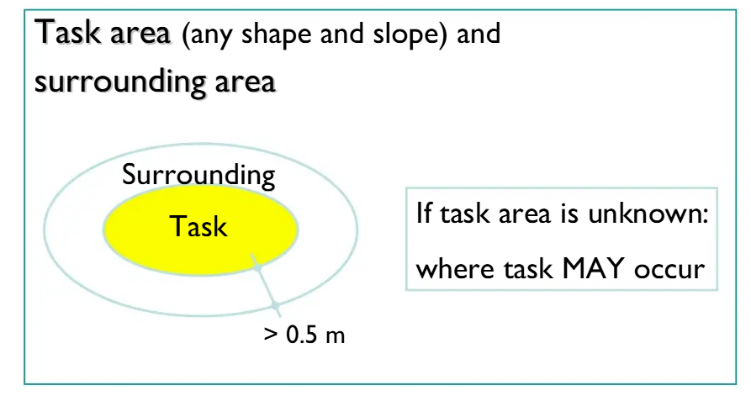
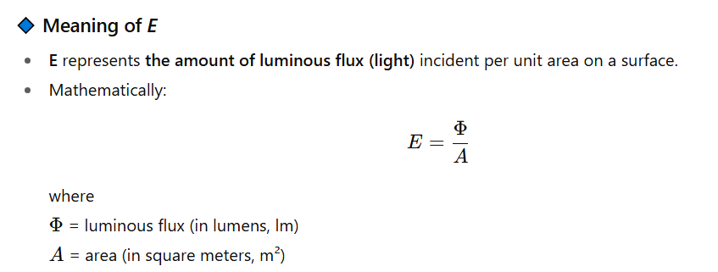
Lighting Illuminance Standard
Reference Standard: SS 531:2006 – Code of Practice for Lighting of Work Places (Part 1: Indoor Lighting),
This slide is for unknown shape of desks
SS 531:2006 – Code of Practice for Lighting of Work Places (Part 1: Indoor Lighting),

Slide 4
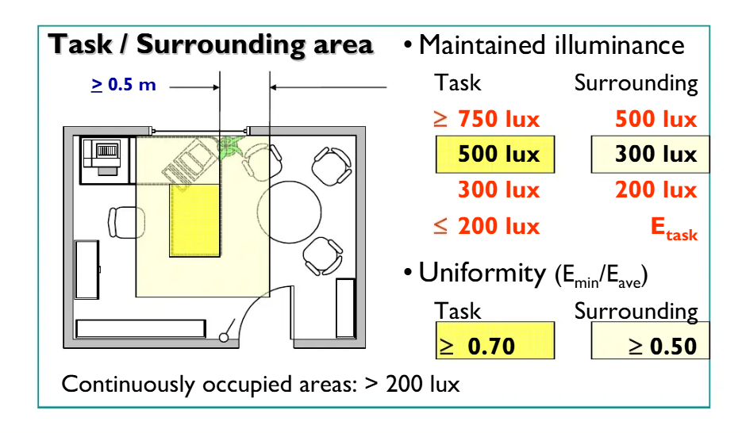
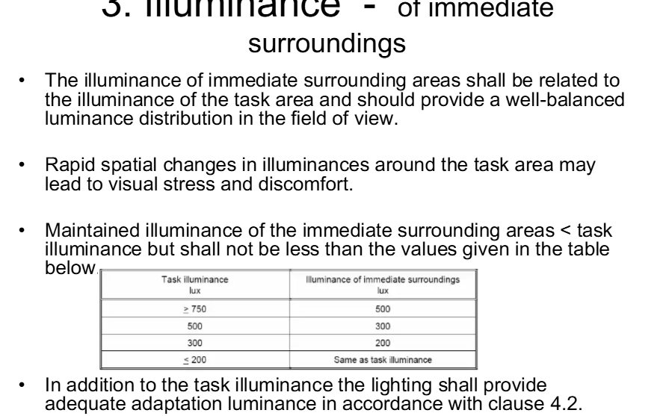
Lighting Illuminance Standard
Desk: 200 to 500 lux
Surrounding: select based on desk.
In climate studio the illuminance needs to be normalized by desk areas
SS 531:2006 – Code of Practice for Lighting of Work Places (Part 1: Indoor Lighting),
https://www.scribd.com/document/444721158/174049966-SS-531-2006-Code-of-Practice-for-Lighting-of-Work-Places-Part-1-pdf

Slide 5
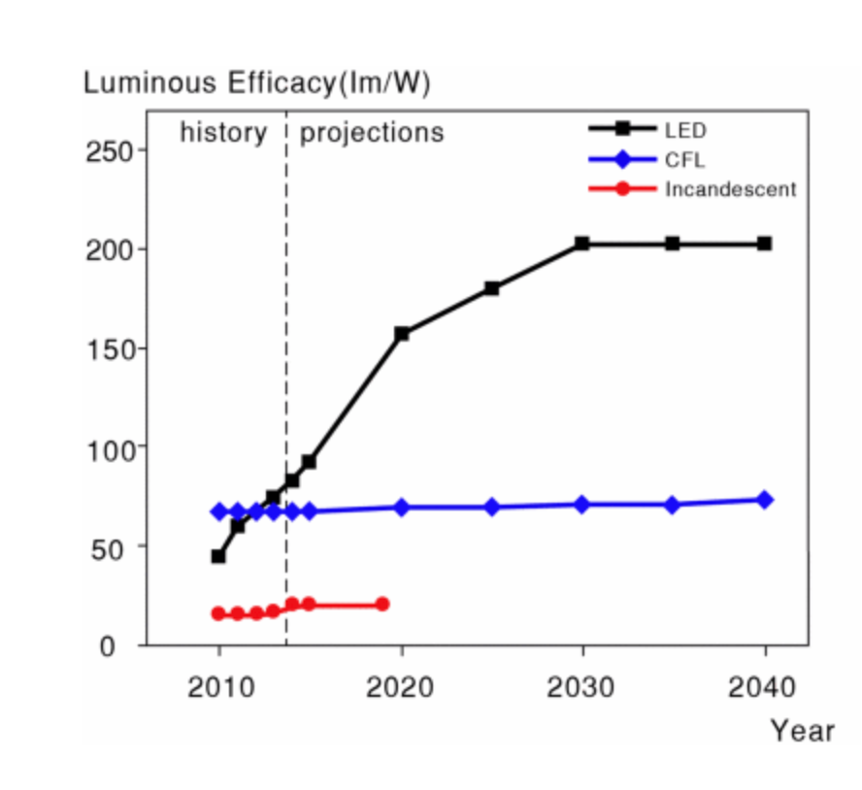
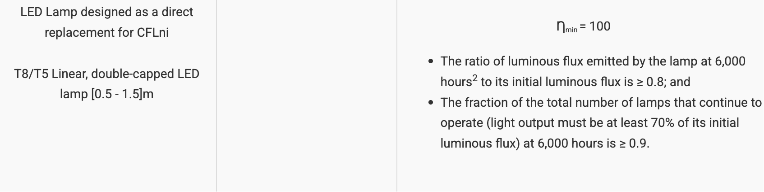
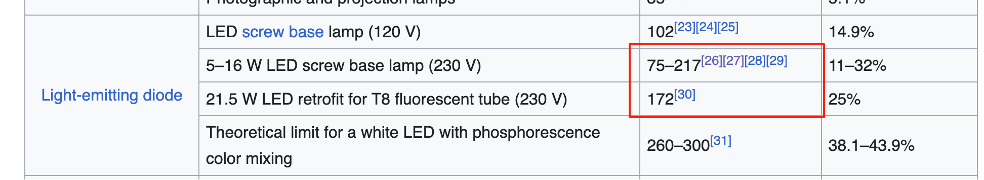
Luminous Efficacy
LED Light: from 100 (minimum requirement by Singapore government) to about 170 lm/w (ideal)
https://en.wikipedia.org/wiki/Luminous_efficacy
https://ieeexplore.ieee.org/abstract/document/8289181/citations#citations
https://www.nea.gov.sg/our-services/climate-change-energy-efficiency/energy-efficiency/household-sector/minimum-energy-performance-standards

Slide 6
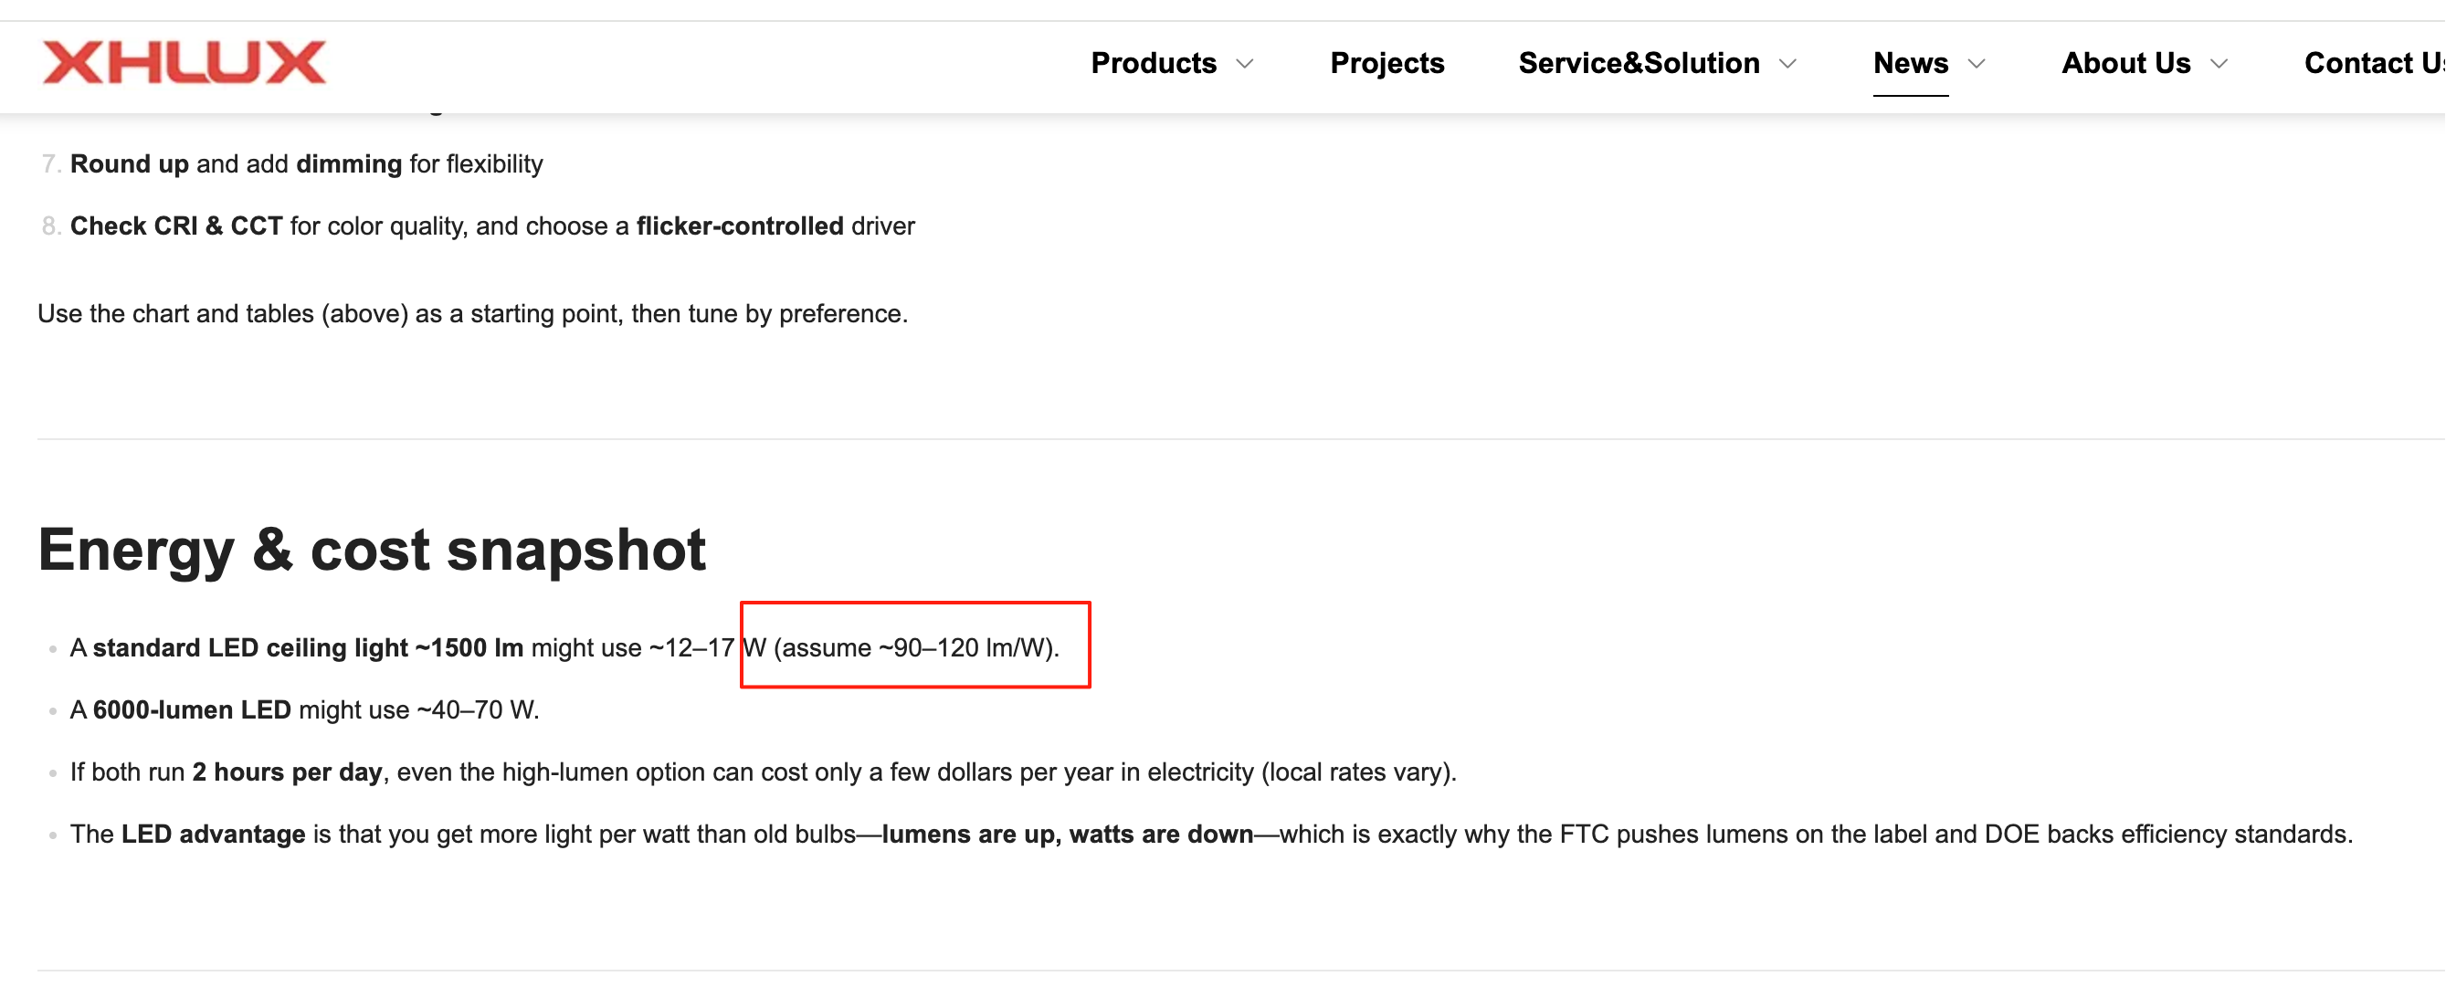
Luminous Efficacy
Ceiling light of one Chinese vendor is 120, FYI.
We can still use the data in the last slide as supporting data
https://www.xhlux.com/ceiling-light-high-lumens-vs-standard-lights-which-is-better

Slide 7
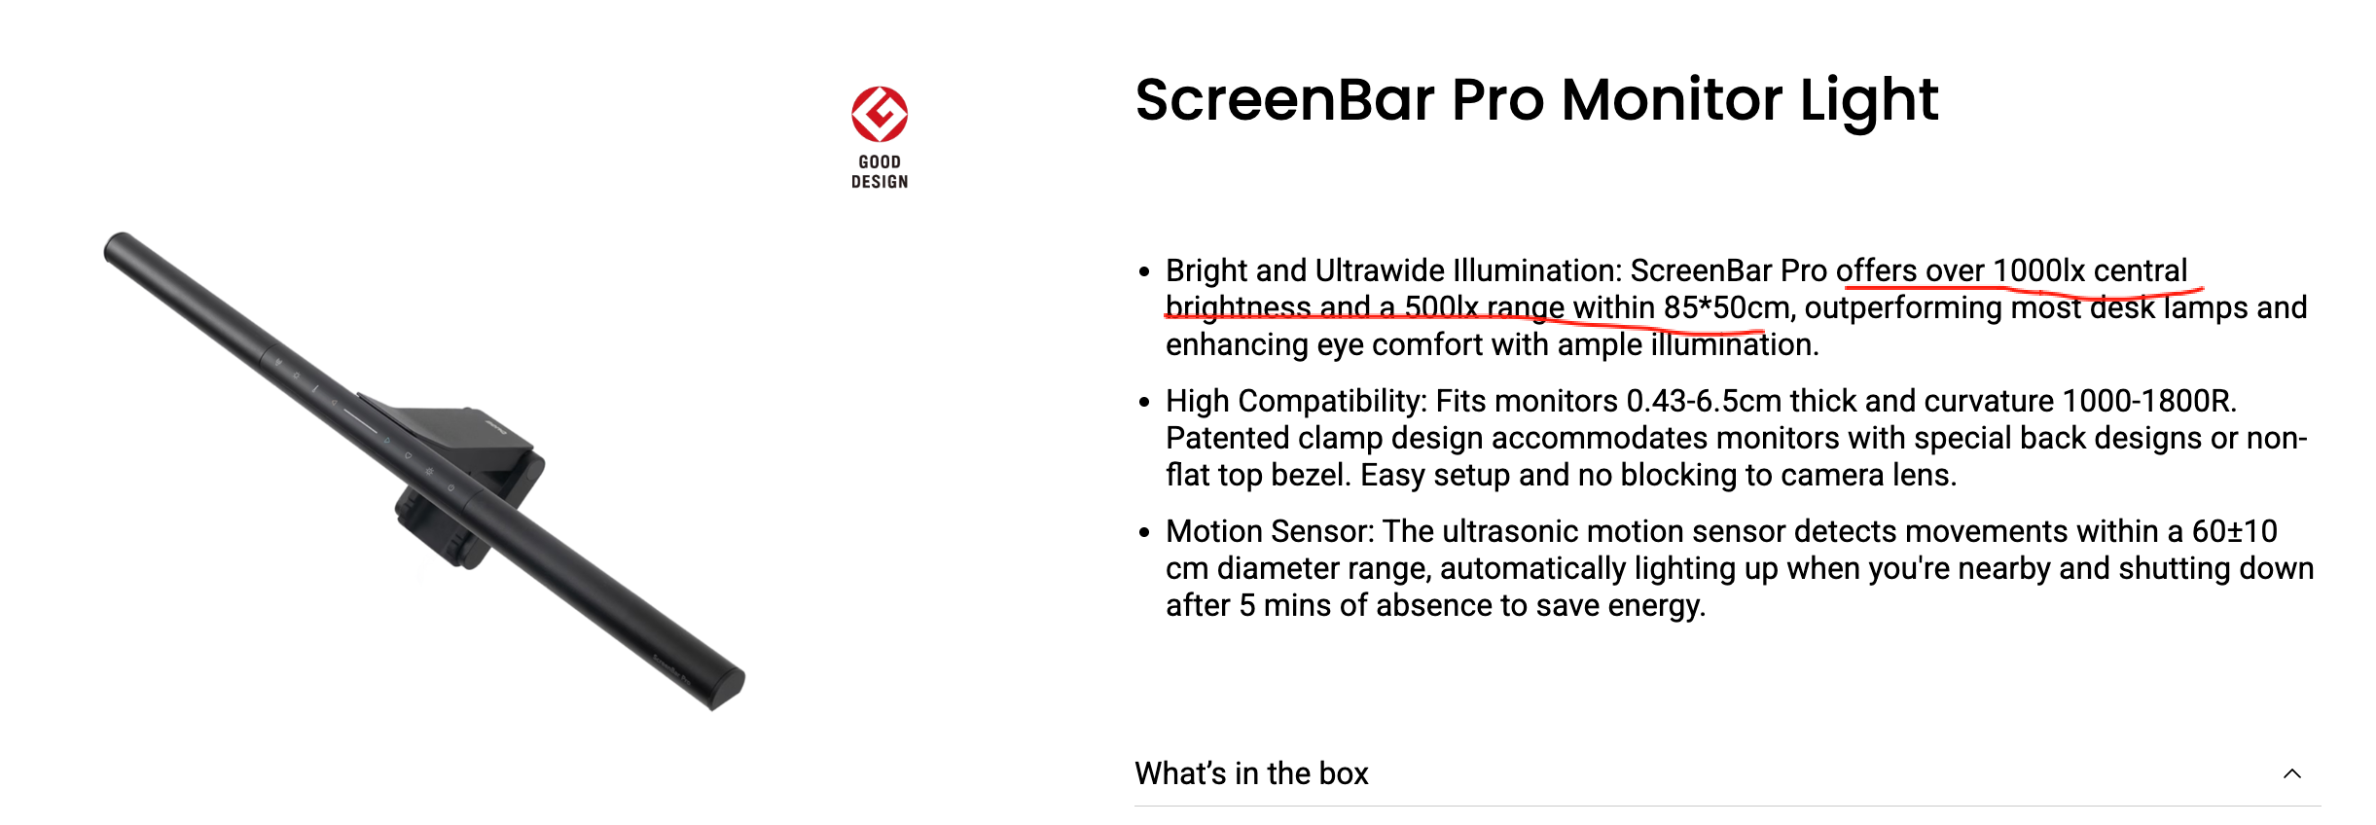
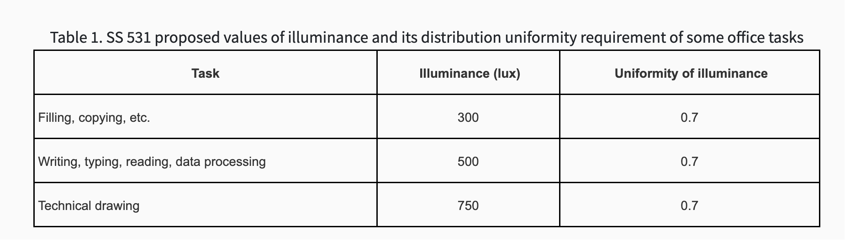
Desk Lighting Illuminance Range
Benq screenpro: 1000lx central brightness and a 500lx range within 85*50cm
Several minimum requirements can be found on government website (screenpro can satisfy)
https://www.benq.com/en-us/lighting/monitor-light/screenbar-pro/buy.html
https://www.a-star.edu.sg/nmc/news-articles/news-and-articles/research-spotlight/working-from-home-are-the-lighting-conditions-ideal?utm_source=chatgpt.com

